Slide 1
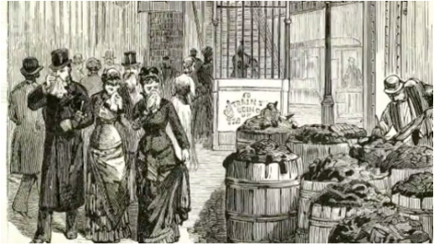

Slide 2
Urban Transformation, 1877-1900

Slide 3
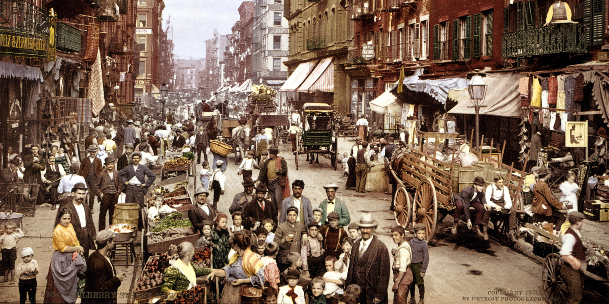

Slide 4
Urbanization
Global Migrations
The Promise and Perils of City Life
Political attack on Urban Problems

Slide 5
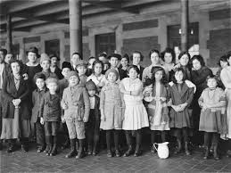

Slide 6
Names and Terms
string migration
remittance
“American Fever”
Cosmopolitan
entertainment
charity
Social Gospel
hygiene
quarantine
regulation

Slide 7
Urbanization
concentration and
congestion
building up and out
distinction and boundaries
Global Migrations
The push and the pull
motivation and means
roundtrips and remittances
foreignness and assimilation

Slide 8
Promise and Perils of City
A world of opportunity
A world of Crisis
Politics and Urban Problems
Problems
Saving Souls in the Cities
private charity
the social gospel
The Social Purity Movement
hygiene programs and sewer systems
Creating Healthy Urban Environment
Government services: fire, police
public regulation of private businesses
https://www.youtube.com/watch?v=Tw4GZeABINI

