Slide 1
Shoshoni (Newe)

Slide 2
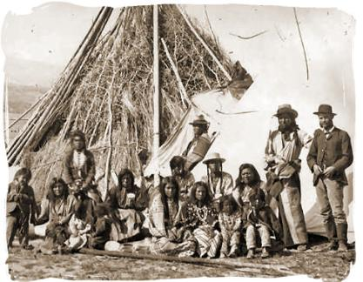

Slide 3
Shoshoni
Traditional Life
Historical Experience
Contemporary Challenges

Slide 4
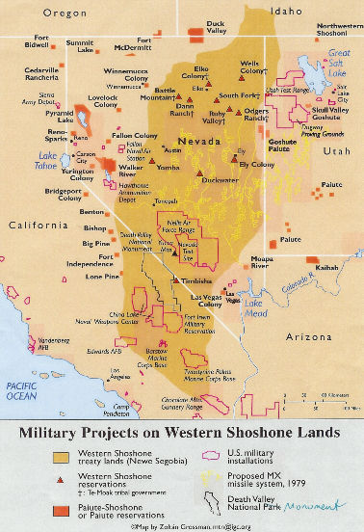

Slide 5
Names and Terms
Great Basin
rye seed
twined basketry
Circle Dance
Humboldt River
Homestead Act
Treaty of Ruby Valley
Ghost Dance
Indian Claims Commission
Rock Creek Canyon Casino

Slide 6
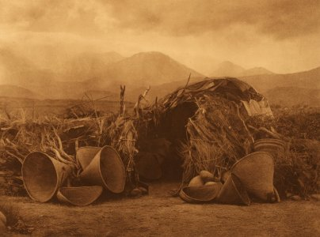

Slide 7
Traditional Life
beaver hunting (until 1850s); cooperative antelope hunting
necklaces and earrings; pigment painting; skins
grass winter houses; sweathouses; small family groups
gathering economies: redtop, rye seed, stickweed, berries, nuts, wild tobacco
twined basketry important; digging sticks (insects)
snares for rabbits, squirrels and birds
self-sufficient individuals and small groups
cousin marriage and lack of in-law avoidance; wife abduction
Circle Dance
https://www.youtube.com/watch?v=b4aLPntsn0k

Slide 8
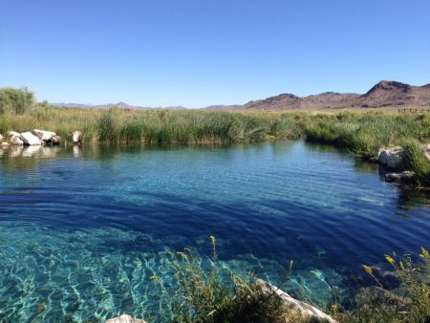

Slide 9
Historical Experience
1820s invasion of trappers along Humboldt River drainage; conflict escalated and beaver population destroyed
1850s Oregon & California trail traffic depleted resources and brought violence
1860s Homestead Act and Nevada Statehood (mining)
1869 Completion of the Transcontinental Railroad
traditional lifeways destroyed; treaty of Ruby Valley violated
1890s Ghost Dance tensions
https://www.youtube.com/watch?v=AnTaYEsXWAk

Slide 10
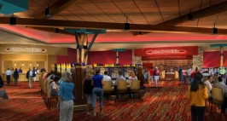

Slide 11
Contemporary Challenges
dealing with shifting policies associated with Citizenship, New Deal Reorganization, Indians Claims commission disputes
Battle Mountain Community and housing issues
development of Rock Creek Canyon casino
dam fight and land disputes and settlement fights
https://www.youtube.com/watch?v=Xk6jGjVXXKc

Slide 12
