Slide 1
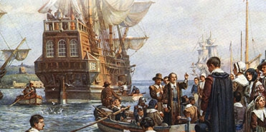

Slide 2
Colonists on the Margins, 1565-1640

Slide 3
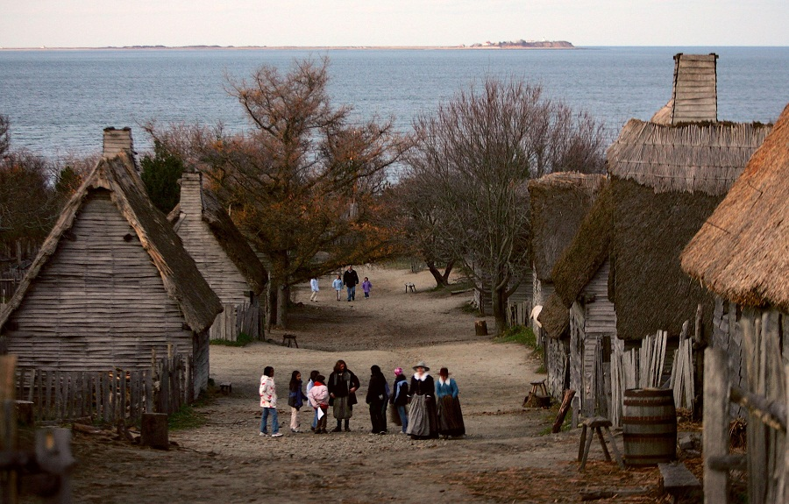

Slide 4
Imperial Inroads and the Expansion of Trade, 1565-1640
European enclaves within Native America, 1607-1625
Expansion of Settler Colonialism, 1625-1640

Slide 5
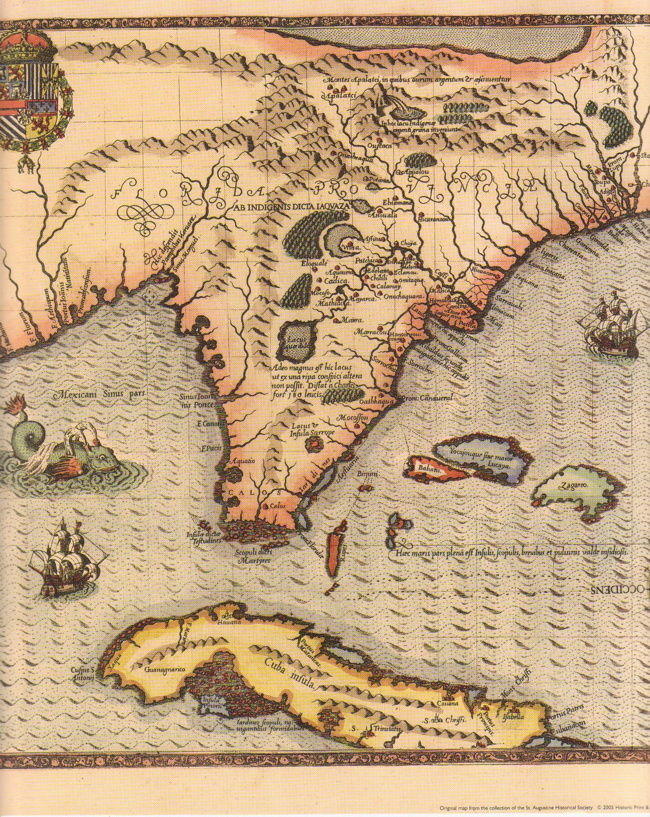

Slide 6
Imperial Inroads and the Expansion of Trade, 1565-1640
Spain Stakes Claim to Florida
Protection of sea lanes and shipwreck salvage
Jesuits and Native subjugation met resistance (Timuci vs. Guales)
St. Augustine under siege
New Spain into the Southwest
Onate and Franciscan settlement
extension of silver empire
Acoma resistance and punishment
exploration to the Pacific
England Enters Eastern North America
population and employment pressures
joint-stock companies and trade hopes; piracy
Roanoke enterprise
The Fur Trade in the Northeast
systematic harvesting
infusion of European goods (copper, brass, woolen cloth)
impacts balance of power: Iroquois vs Huron
https://www.youtube.com/watch?v=6PCnyWJL5d4

Slide 7
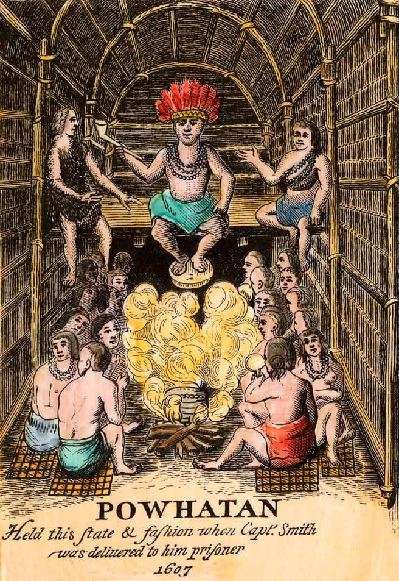

Slide 8
European Enclaves within Native America, 1607-1625
Tsenecomoco and Virginia
Jamestown and gold fever; indentured labor
challenge to Tsenecomoco network (Pocahantas)
inefficiency and dependence on Indian staples
instability, attrition and company failure
New France, New Netherland, New Indian Northeast
French (St. Lawrence) and Dutch (Hudson) strongholds: furs and fish
tribal sponsorship and deadly competition
Pilgrims and the Northeastern Natives (1620)
Plymouth and land issues
Tisquantum (Squanto) and tribal conflict
Massasoit alliance (Pokanoket); languishing population
https://www.youtube.com/watch?v=YUhH24SXrLE

Slide 9
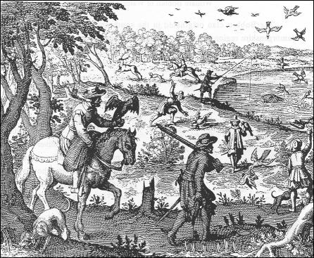

Slide 10
Expansion of Settler Colonialism, 1625-1640
Missionaries and Indians in New France and New Mexico
Jesuits and conversion pressures (Hurons, Pueblos)
practical economic alliances
Franciscans and spiritual conquest
slavery and disruptions of patrilineal systems
Migration and the Expansion on Dutch and English North America
demographic shifts and contested land (English) (100,000)
organized Massachusetts Bay: John Winthrop
cosmopolitan Manhattan
Dissent in the “City on a Hill”
civil and ecclesiastical authority
orthodoxy and doctrinal tests
literacy and individual piety
crackdown and exile (Williams, Hutchinson)
Early Wars between Colonists and Indians
settler colonialism and demand for land
European conceptions of rank and order
continual effects of disease
Virginia and Opechancanough Uprising
Massachusetts and the Pequot War
“Just war” spoils and instability
https://www.youtube.com/watch?v=5elHCR3Xtns

