Slide 1
Religion, Ideas, and conflict in North America, 1730-1763

Slide 2
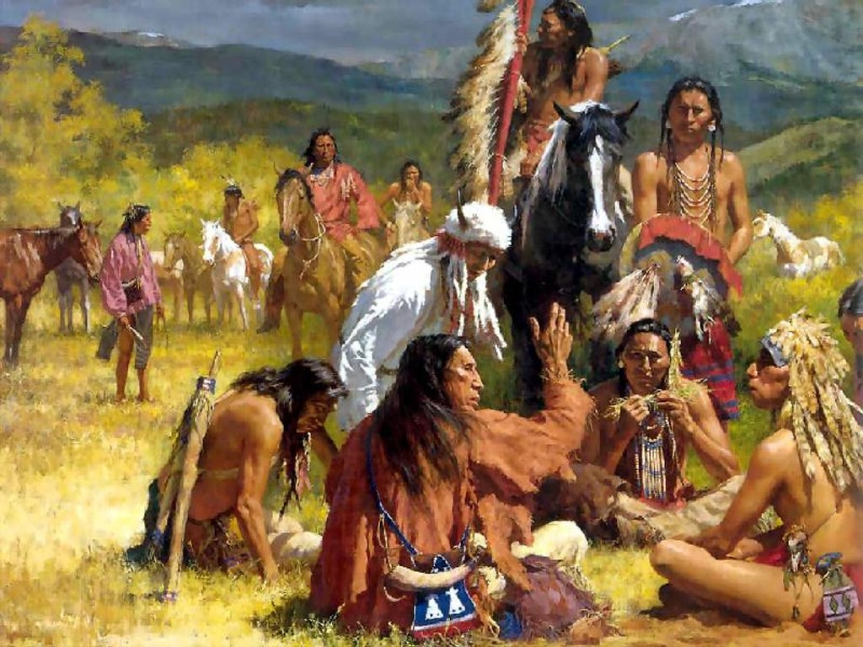

Slide 3
Immigrants and Indians
Ideas, Religion, and Economics
North America and the French and Indian War, 1753-1763

Slide 4
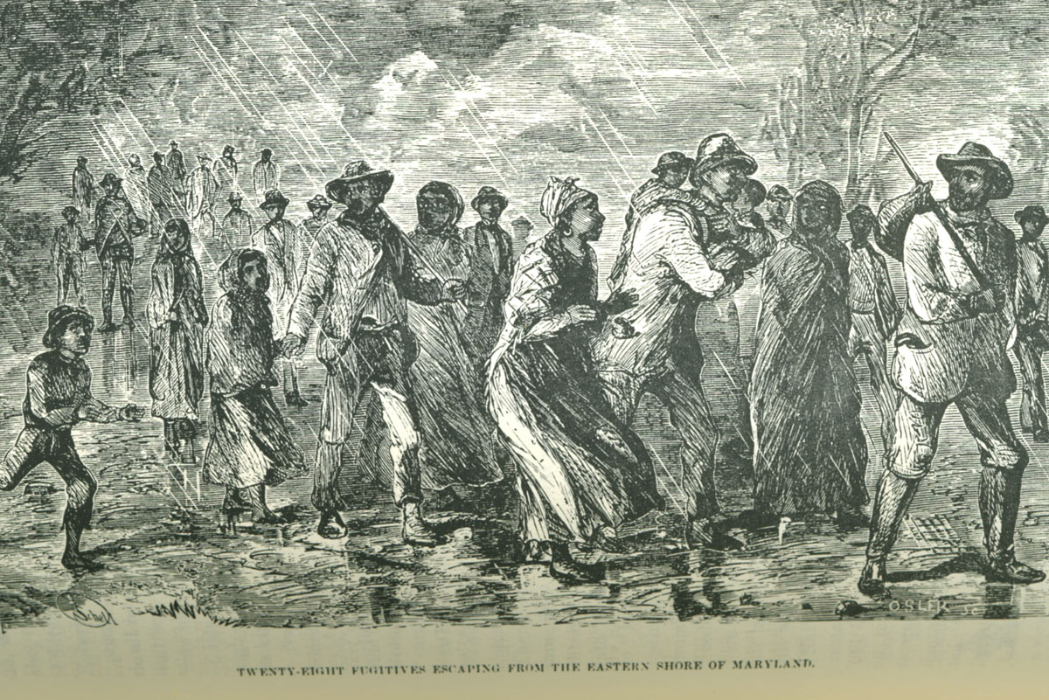

Slide 5
Immigrants and Indians
The Arrival of Immigrants in Chains
Increase in British slave transportation between 1730-1763: Rhode Island based
South Carolina and Virginia imported most for agricultural work
Northern population of slaves rose dramatically—served in cities as domestic servants
British and Irish convict dumping; ½ of all British immigration
The Impact of Irish and German Immigration
Irish made up ½ of all British immigration, many as the final indentured servants
in the Chesapeake
Scots-Irish settled inland in Pennsylvania/Maryland, or Southern Appalachia
surge of German Immigrants to Pennsylvania, New York and Carolinas; slow to assimilate
Indian Displacement and the Rise of the Sioux, Osage, and Comanche
multiple Indian regions invaded by immigrants
horses and guns created aggressive Native empires: Sioux, Osage, Comanche
disease devastated Hidatsas, Mandans, Arikaras
many bands and tribes of refugees
Great Plains transformed by the horse and gun; bison hunting cultures
Slave Resistance and the Creation of Georgia
Georgia founded as a non-slave buffer with Spanish Florida
Florida as a runaway slave refuge—1739 Stono and Caribbean rebellions
Rice gave way to indigo as crops were diversified
Migration from South Carolina to George lifted salve ban by 1750
https://www.youtube.com/watch?v=AUshUlDlRoY

Slide 6
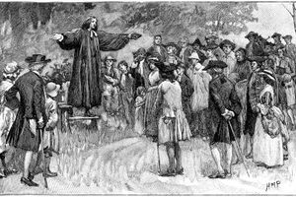

Slide 7
Ideas, Immigrants, and Economics
North Americans engage the Enlightenment
reason as key to progress; search for universal laws; challenge to arbitrary authority, monarchs or clergy
North America fully participated through newspapers and pamphlets (mail), and public libraries
colonial colleges to train clergy by 1760; secular studies as well
Benjamin Franklin, American Philosophical Society and amateur science
Becoming a Consumer Society
flood of British-made goods and debt
tea-drinking and importation
colonial ships carried most trans-Atlantic cargo
slaves under gang and task systems (income and trade)
English control (Navigations Acts) in response to growing colonial markets
Revivals and the Rise of Evangelical Christianity
English preachers brought evangelical Christianity to the colonies; emphasized individual piety and relative equality in religion
emotion (enthusiasm) more important than theology or education
Moravians and colonial revivals; “new light” imitators—Jonathan Edwards
mass meetings that ignored class and gender norms; challenged “old light” authority
African, African American and Indian Awakenings
spiritual equality contrasted to racial subordination to masters
Black, Mohican and Delaware conversions to “new Light” style
pan-Indian religious movements incorporated ethics, piety, and Native cultural restoration – Samuel Occom, Neolin (Pontiac)
https://www.youtube.com/watch?v=AgqA4ZJ6aeg

Slide 8
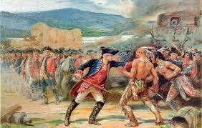

Slide 9
North America and the French and Indian War, 1753-1763
Struggle for the Ohio River Valley
skirmish between French, British, and Indians in western Pennsylvania erupted into a world war (Seven Year’s War)
since 1740s, Iroquois played a balancing act between French and British
Virginia speculators moved into the Ohio Rive Valley; French laid claim to area to block British settlement, Fort Duquesne, 1754
British countered by building Fort Necessity (Washington); French and Indians destroyed it
The Course of War
English (Braddock) defeated at Monoghela; Indians raided Pennsylvania, Maryland, and Virginia
French and Indian alliance weakened over trade goods by 1758
British (Pitt) held French forces down in Europe; they abandoned North America
tens of thousands of colonials fought in war; sacrificed men and wealth
British took over islands in the Caribbean and Philippines
New Divisions
British gained Florida and Canada, lands east of the Mississippi; Natives in Ohio River Valley turned on British; 1763 Parliament barred colonization west of the Appalachian mountains
colonials resented servile role and lack of spoils
Refugees and exiles
deportation of French from Nova Scotia to Louisiana (Cajuns) 10,000
Spanish migrated from Florida to Cuba and Mexico
https://www.youtube.com/watch?v=f4zpXaxg3is

