Slide 1
The First American National Government Experiment

Slide 3
The Confederation: a national government limited in power
established a Congress with a unicameral structure (one decision-making body) that only represented the state governments
members of congress were appointed annually by the state legislatures, which paid them
each state, regardless of size, had only one vote
Congress could enact legislation, but states had to voluntarily enforce or follow them
there was no executive branch and no national judicial system
Independent states were afraid to give the national government powers over the states
Congress was allowed very few powers: it could declare war (appoint military officers) and negotiate peace (make treaties and alliances); it could coin and borrow money; it could regulate trade with Native tribes
States could independently compete for foreign trade

Slide 4
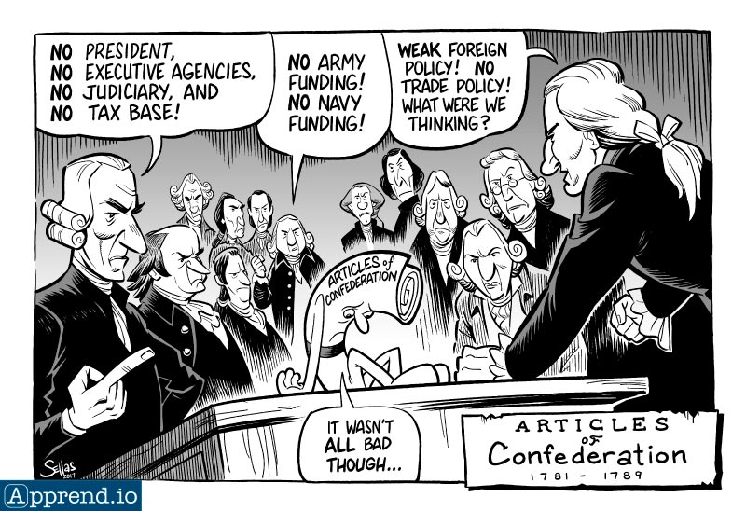

Slide 5
Weaknesses of the Articles of Confederation
Economic – each state coined their own currency, which became in short supply; each state could set its own tariffs with both foreign countries and other states, which made barriers to trade; only states could tax the people, and they failed to contribute what they promised
Administrative – national government could not solve disputes between states; state judiciaries issued conflicting legal decisions; states could reject national laws without consequence; states could enact legislation contrary to national treaties
Lack of a national judiciary meant movement toward greater legal inconsistencies for citizens of various states
Lack of an executive meant a lack of accountability: since all states were accountable for the execution of laws, no one entity was responsible for proper execution
Shay’s Rebellion exposed weaknesses within state governance
democratic resistance to legal requirements to repay debts and pay taxes was uncontrollable; threatened to breakdown of economic and trade systems
governments of other states and the national government were unable to adequately assist
state legislatures were pressured to annul crucial foundational civic requirements of an orderly society
the right to bear arms translated into an atmosphere of civic rebellion

Slide 6
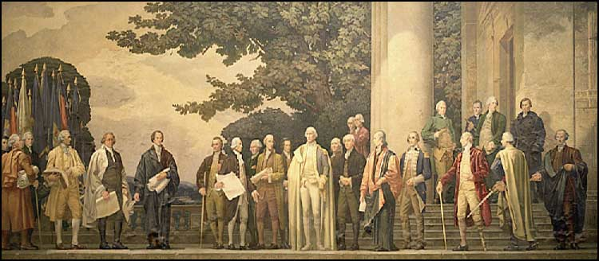

Slide 7
Constitutional Convention
The Convention Delegates
Fifty-five framers were not leading a “revolution;” they were economic, educational, and intellectual elites; majority were slave holders or made money tangential to the slave system
They were all male, Christian, and Euro-American
Forming a New Government
Some participants wanted a major shift to a national (unitary) government powerful enough to provide security and to solve problems; wanted it to be democratic, republican with safeguards against tyranny and oppression
Others wanted to stay with a confederation that allowed states to continue to be the center of power with a weak national government (protection from tyranny and oppression)
The Great Compromise
A mix of unitary and federal characteristics that created a strong national government with carefully constructed balances and limits
national: a president (with veto and domination power), a national judiciary, a House of Representatives (of the people, not the states), national government right to tax citizens directly, national laws take precedence over state laws
federal: Three branches of national government; a Senate (of the states, not the people); powers reserved for the states, the Bill of Rights, state governments determine status of slavery in their states
key compromises: slave trade legal for twenty years; representation and taxation count includes population of slaves

Slide 8
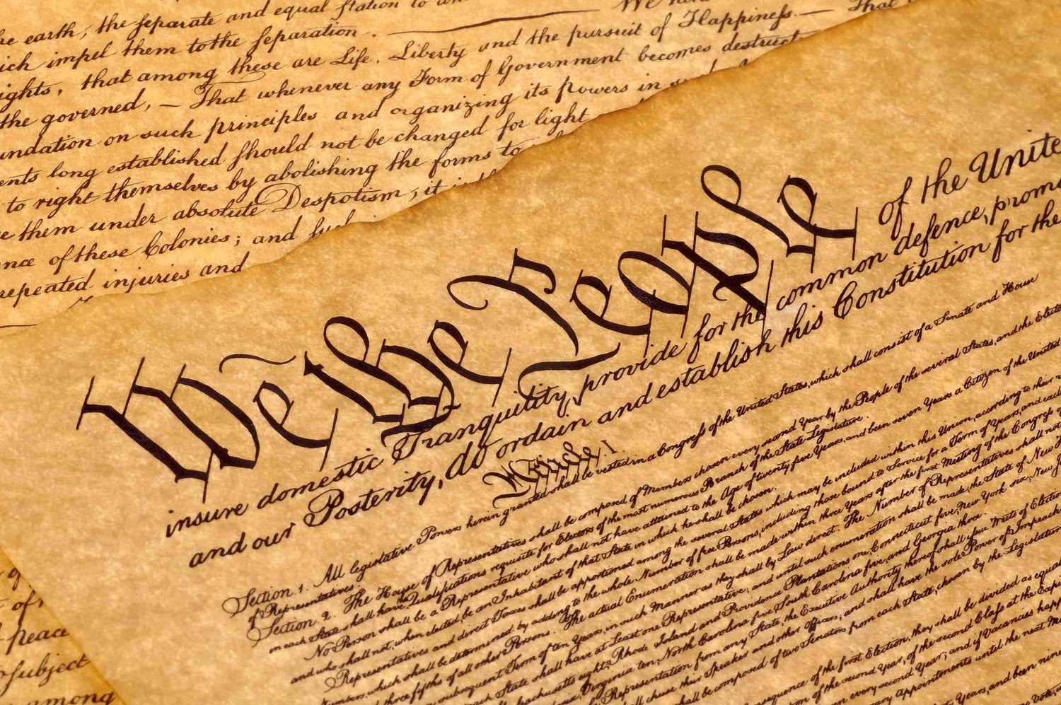

Slide 9
The Constitution and Bill of Rights
Ratification Debate
nationalists were desperate to get the compromised Constitution ratified (writing of the “Federalists Papers”); they predicted the complete failure of the United States if ratification failed; Washington, Hamilton, Madison, Franklin
most Articles of Confederation supporters were against the ratification of the compromised Constitution because it went too far; they felt that it betrayed the spirit of Independence because it resembled the British unitary system too much; Sam Adams, Henry, Mason, Randolph
some Articles supporters were willing to agree to the Constitution with changes; wanted an additional convention, but settled for a Bill of Rights
Constitution ratified with two votes very close: NY (five), Virginia (three)

