Slide 1
A New Nation Facing a Revolutionary World, 1789-1815

Slide 2
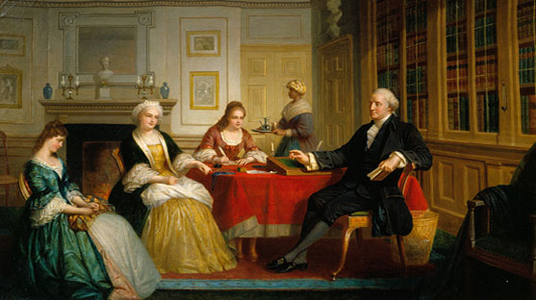

Slide 3
The US and the French Revolution
Party Conflict Intensifies
“Revolution” of 1800 and 1804
Trade, Conflict, and Warfare
The War of 1812

Slide 4
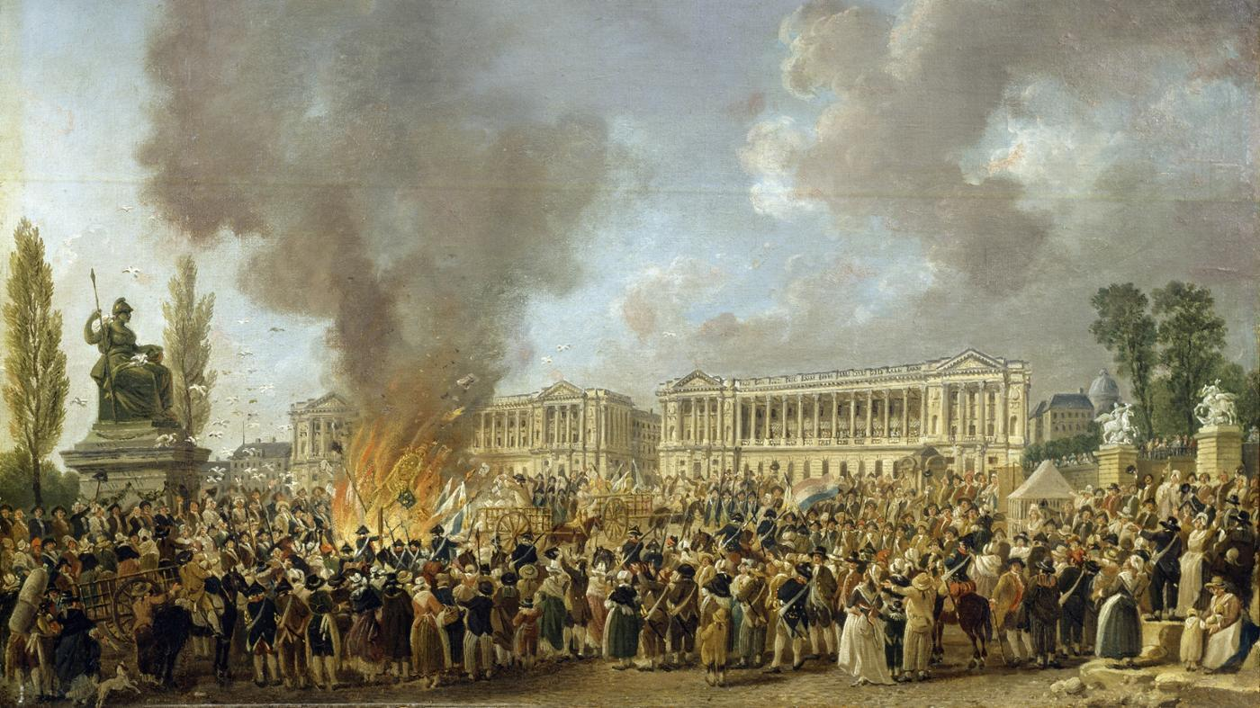

Slide 5
Names and Terms
monarchical
George Washington
factions
John Adams
Barbary
Thomas Jefferson
Haiti
Tecumseh
Pan-Indian
War of 1812

Slide 6
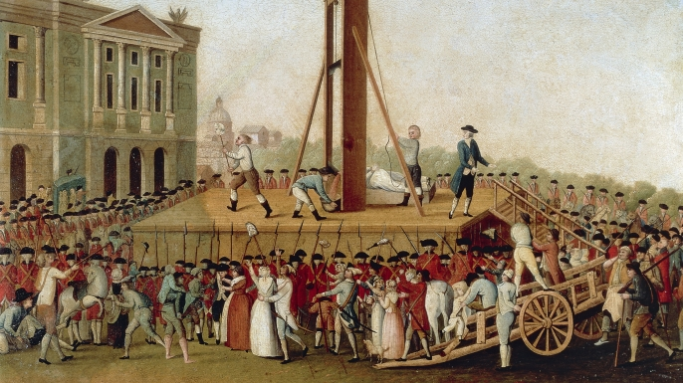

Slide 7
The US and the French Revolution
New Nation and the New Revolution
The Rise of Party Tensions
Neutrality and Jay’s Treaty
Popular Politics of Rebellion
Indian Warfare and European Power
https://www.youtube.com/watch?v=LS95qRxNUyg

Slide 8
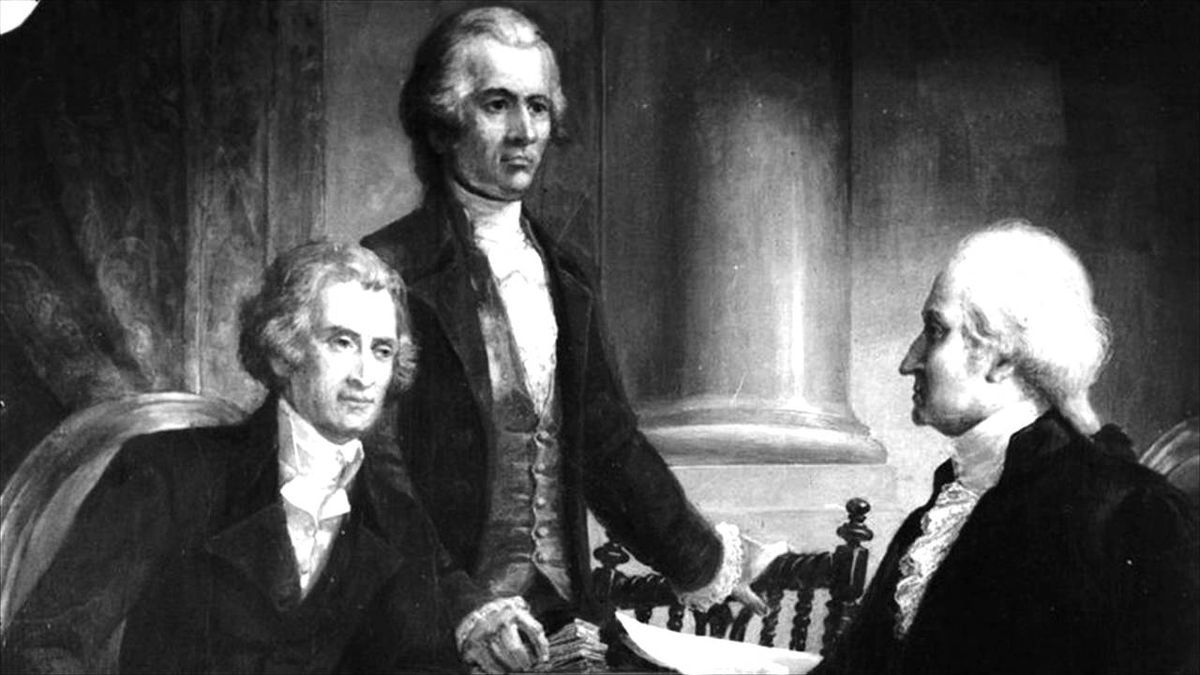

Slide 9
Party Conflict Intensifies
Adams in Power
Alien and Sedition Acts
Slave Rebellions
https://www.youtube.com/watch?v=dIM1c3Sp-FE

Slide 11
The “Revolutions” of 1800 and 1804
Jefferson Elected
Democracy: Limits and Conflicts
Haitian Revolution
The Louisiana Purchase
https://www.youtube.com/watch?v=SZAwJvZdbCg

Slide 12
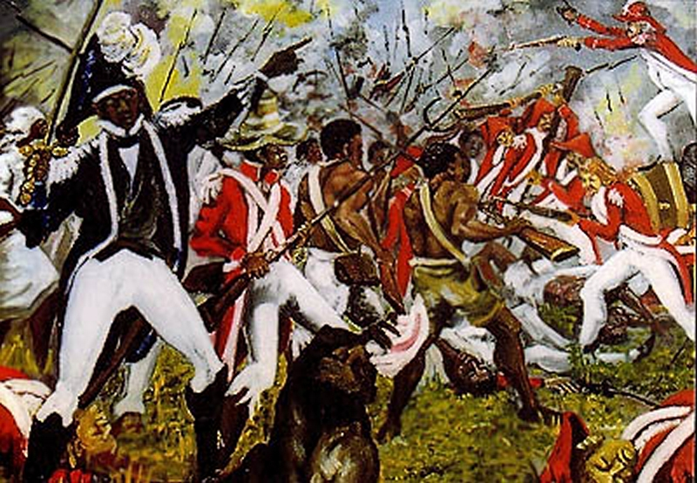

Slide 13
Trade, Conflict and War
Transatlantic and Caribbean Trade
Mediterranean Trade: Barbary Wars
Western Discontents
European Wars and Commercial Sanctions
https://www.youtube.com/watch?v=6YkfQos8mN8

Slide 14
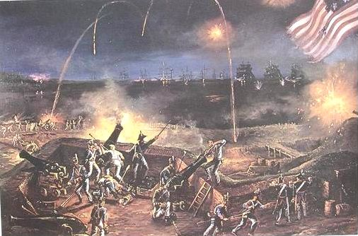

Slide 15
The War of 1812
War Declared
Opposition to the War of 1812
US offensives in Canada
Tecumseh and Pan-Indian Resistance
Naval War
British Offensive
The War Ends
https://www.youtube.com/watch?v=ibvUUnFzAFg

